Slide 1

airbnb Toronto

Slide 2





Agenda
Introduction
Data Description & Cleaning/Wrangling
Analysis Methodology
Results & Recommendations
Summary

Slide 3






Executive Summary
About us:
Top housing platforms offering alternative and less expensive vacation rentals
Focus: Toronto, ON
Opportunity:
Identify which attributes most impact price and review scores
Stakeholders:
External: Hosts, renters
Internal: Marketing, Data engineers, Programmers
Target:
2%
Commissions
Plan to increase Price:
1. Offer review incentives
2. Recommended price adjustments
Plan to improve Reviews:
1. Audit listing accuracy where score is below 3

Slide 4

Introduction
2008
2019
2020
2022 +
Established
Impact of Global Pandemic
Company goes Public
Opportunity to Increase Sales
Online housing platform offering cheaper vacation retinal alternatives for travellers compared to more expensive hotel accommodations
Travel restrictions have little impact on airbnb sustainable business model
Business thriving, airbnb becomes a public entity
As post COVID economies in various sectors regain foothold, belief that demand for travel will flourish
To maximize potential revenue, airbnb hosts can make use of attributes that drive booking price and improve these features for the benefit of travellers
Goal: Increasing revenue by 2% through increasing commissions for airbnb
Introduction
Description & Cleaning
Analysis Methodology
Recommendations
Summary

Slide 5
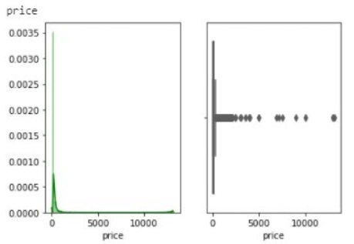
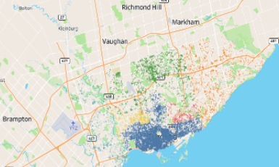

Data Description Cleaning & Wrangling
Original Dataset
SimpleImputer (Categorical) and IterativeImputer (numerical) from Sklearn Python used to impute missing values
74 variables and 19,343 total records located in Toronto, ON only
Irrelevant data, i.e. listing_url
Missing 40% or more of values
Removal of Feature Variables
Host Since
Host Response
Host Acceptance
Former City - grouped 70+ neighbourhoods into 6 cities (fig. below)
Interquartile range (IQR) method applied for detecting and removing outliers (fig. below)
Impute Missing Values
Outlier Detection
Feature Engineering
Introduction
Description & Cleaning
Analysis Methodology
Recommendations
Summary

Slide 6
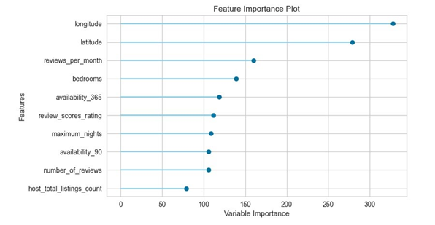
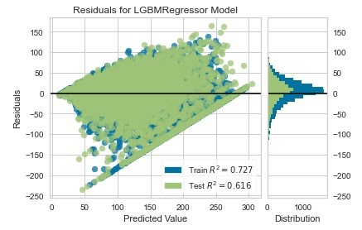
Analysis Methodology - Price Model
Feature Variables
Algorithm/Model
Test/train split (70/30)
10 folds for validation
Light Gradient Boosting Machine
RMSE as chosen metric
Model Evaluation
Overlap of test and training set residuals consistent
No significant overfitting in the training set
1
2
3
Introduction
Description & Cleaning
Analysis Methodology
Recommendations
Summary

Slide 7
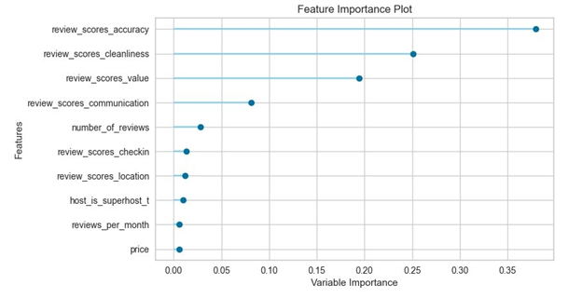
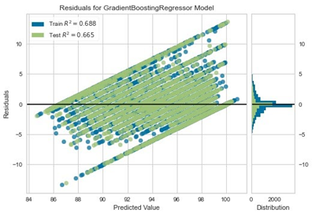
Analysis Methodology - Reviews Score Ratings Model
Feature Variables
Algorithm/Model
Test/train split (70/30)
10 folds for validation
Gradient Boosting Regressor
R-squared as chosen metric
Model Evaluation
Overlap of test and training set residuals consistent
No significant overfitting in the training set
1
2
3
Introduction
Description & Cleaning
Analysis Methodology
Recommendations
Summary

Slide 8
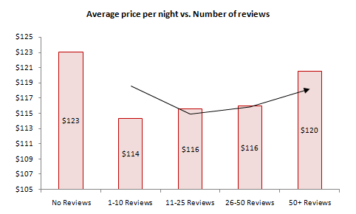
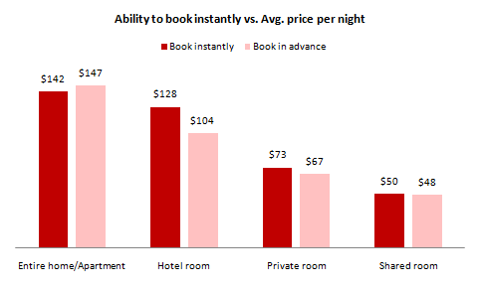
Results & Recommendations: Price
Offer incentives to renters to leave reviews
Create an algorithm which provides the host with guidance of adjusting the price based on the booking window
Create an algorithm which generates guidance for hosts to identify if their set price per night is within a standard/high/low range
Introduction
Description & Cleaning
Analysis Methodology
Recommendations
Summary

Slide 9
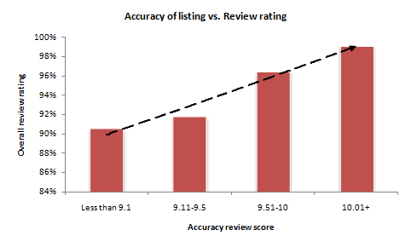
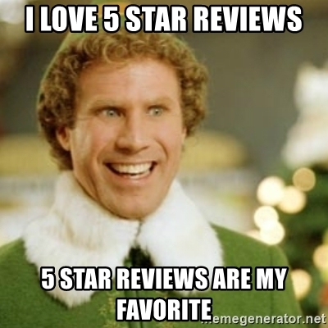
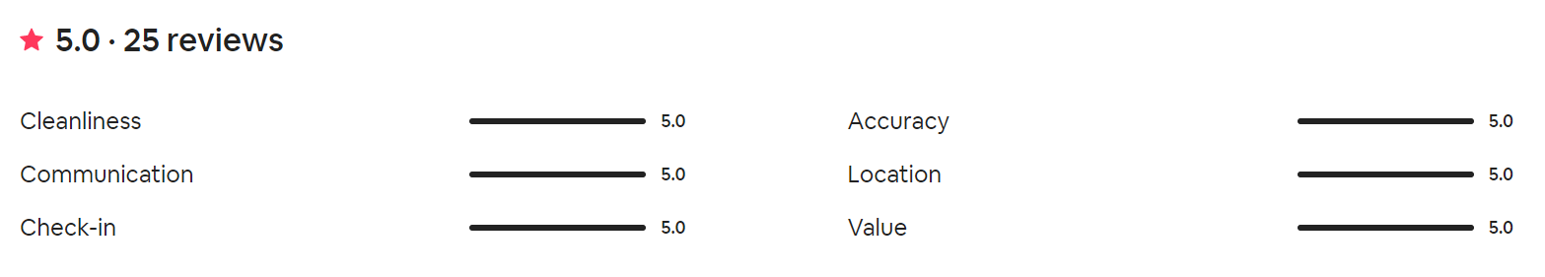
Results & Recommendations: Review Score
Implement internal audit/review process when accuracy score is low, requiring corrective action from the host
Introduction
Description & Cleaning
Analysis Methodology
Recommendations
Summary

Slide 10




Summary
Increase Price & Improved Review Scores = Added Commissions
Create algorithmic recommendations to hosts for price adjustments based on booking window and standard price for similar properties
Begin offering incentives for renters to leave reviews
Implement internal audit and review process when listing accuracy scores low
Top Features
Top Features
2%
Location
Number of reviews
Commissions
Instant booking
Listing accuracy
Introduction
Description & Cleaning
Analysis Methodology
Recommendations
Summary

